Slide 1

MODEL QUESTION PAPER DISCUSSION
STRENGTH OF MATERIALS
SUBJECT CODE : 3021
MUHAMMED SAFVAN A
REVISION 2021

Slide 2
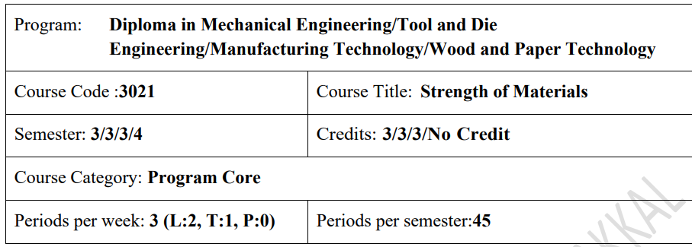

Slide 3
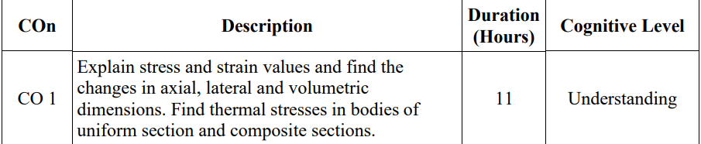
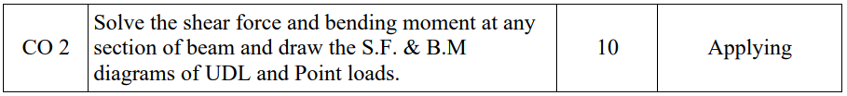
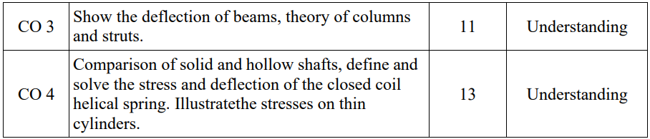
Course Outcomes:

Slide 4
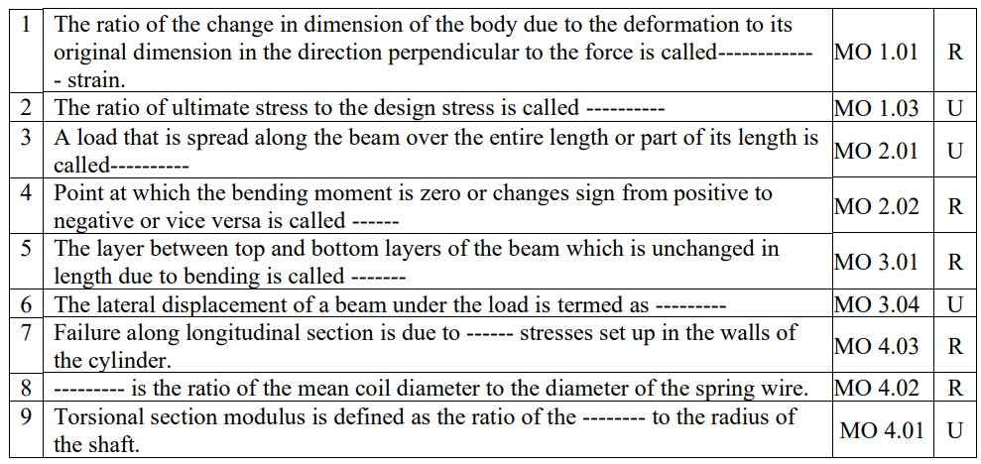
Answer all questions in one word or one sentence
(9 x 1 = 9 Marks)

Slide 5
The ratio of the change in dimension of the body due to the deformation to its original dimension in the direction perpendicular to the force is called------------ - strain. LATERAL STRAIN
The ratio of ultimate stress to the design stress is called ---------- FACTOR OF SAFETY
A load that is spread along the beam over the entire length or part of its length is called---------- UNIFORMLY DISTRIBUTED LOAD

Slide 6
4. Point at which the bending moment is zero or changes sign from positive to negative or vice versa is called ------ POINT OF CONTRAFLEXURE
5. The layer between top and bottom layers of the beam which is unchanged in length due to bending is called ------ NEUTRAL LAYER
6.The lateral displacement of a beam under the load is termed as --------- DEFLECTION

Slide 7
7. Failure along longitudinal section is due to ------ stresses set up in the walls of the cylinder. HOOP
8. --------- is the ratio of the mean coil diameter to the diameter of the spring wire SPRING INDEX
9. Torsional section modulus is defined as the ratio of the -------- to the radius of the shaft. POLAR MOMENT OF INERTIA

Slide 8
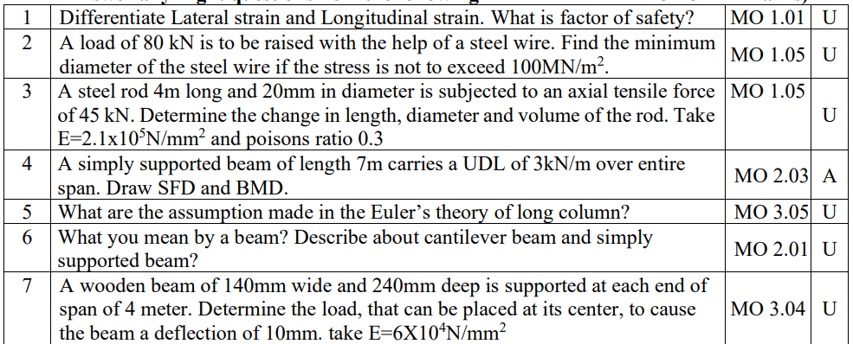
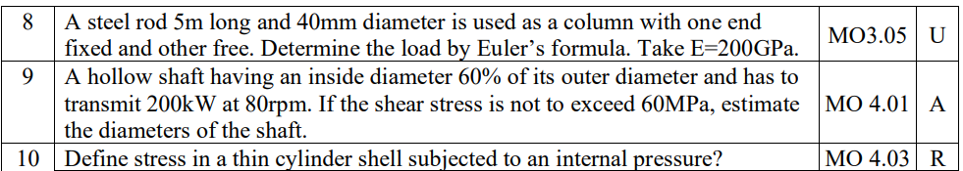
Answer any Eight questions from the following
(8 x 3= 24 Marks)

Slide 9
Differentiate Lateral strain and Longitudinal strain. What is factor of safety?
Longitudinal strain refers to the deformation that occurs along the length of an object when subjected to a force parallel to its original direction.
Lateral strain refers to the deformation that occurs perpendicular to the applied force, causing the object to expand or contract in its transverse directions.
The ratio of lateral strain to the longitudinal strain is called Poisson’s ratio
Factor of safety:The ratio of ultimate stress to working stress is called factor of safety.

Slide 10
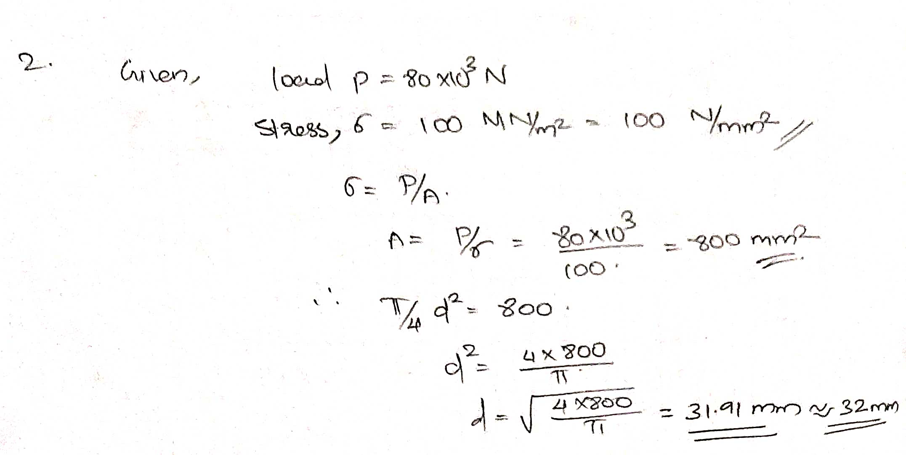
2. A load of 80 kN is to be raised with the help of a steel wire. Find the minimum diameter of the steel wire if the stress is not to exceed 100MN/m2 .

Slide 11
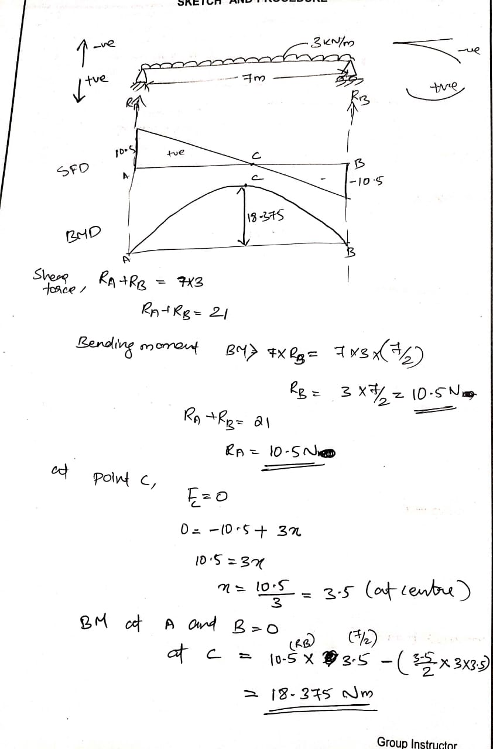
4. A simply supported beam of length 7m carries a UDL of 3kN/m over entire span. Draw SFD and BMD.

Slide 13
5. What are the assumption made in the Euler’s theory of long column?
The column is initially straight and the applied load is truly axial.
The material of the column is homogeneous, linear and isotropic and obeys Hookes law.
The length of the column is very large as compared to the cross sectional area of the column.

Slide 14
6. What you mean by a beam? Describe about cantilever beam and simply supported beam.
A member subjected to external forces which are act at right angles to its longitudinal axis is called beam.
Cantilever beam: a beam with one end fixed and other end free is called cantilever beam
Simply supported beam: a beam which is freely supported at both ends is called simply supported beam .

Slide 15
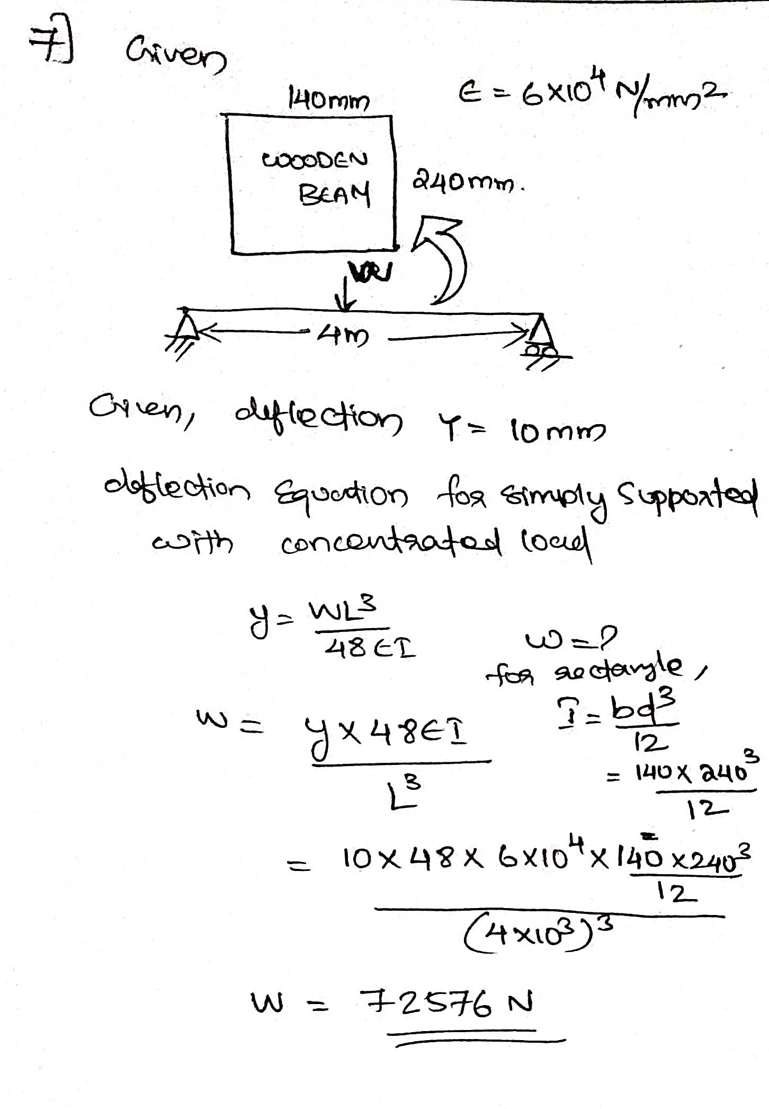
7.A wooden beam of 140mm wide and 240mm deep is supported at each end of span of 4 meter. Determine the load, that can be placed at its center, to cause the beam a deflection of 10mm. take E=6X104N/mm2

Slide 16
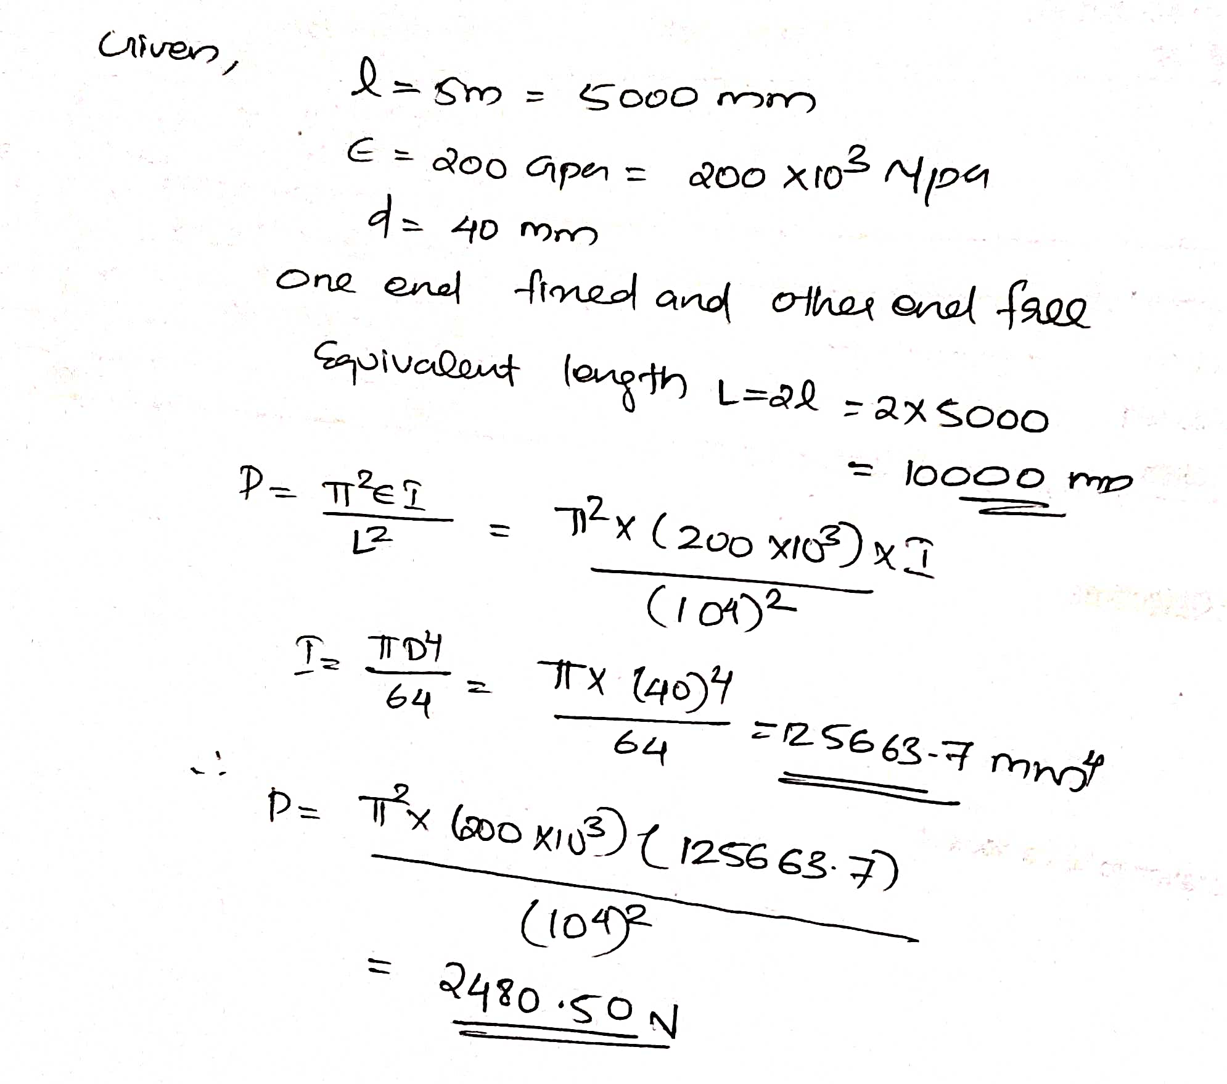
8.A steel rod 5m long and 40mm diameter is used as a column with one end fixed and other free. Determine the load by Euler’s formula. Take E=200GPa.

Slide 17
10. Define stress in thin cylinder shell subjected to an internal pressure?
When the shell is filled with fluid, its walls experience the following tensile stresses.
1)Hoop or circumferential stress which acts normal to the axis of the shell
2)Longitudinal stress which acts parallel to the axis of the shell.

Slide 18
PART C
Answer all questions from the following
(6x 7 = 42 Marks)
Most important portion

Slide 19
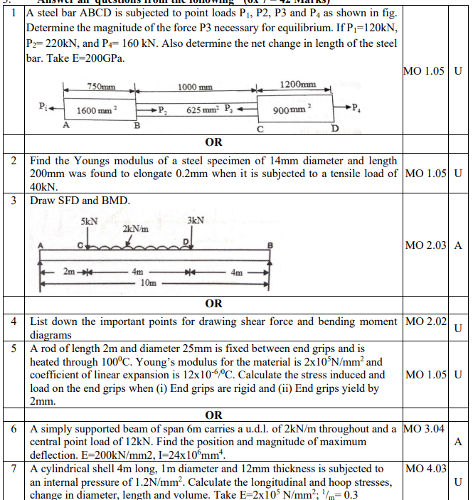

Slide 20
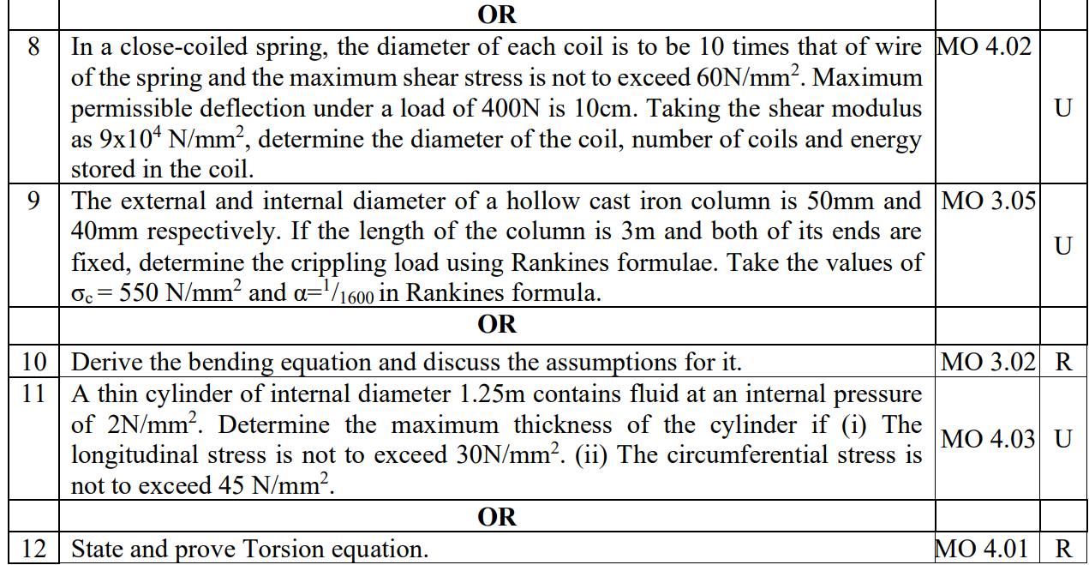

Slide 21
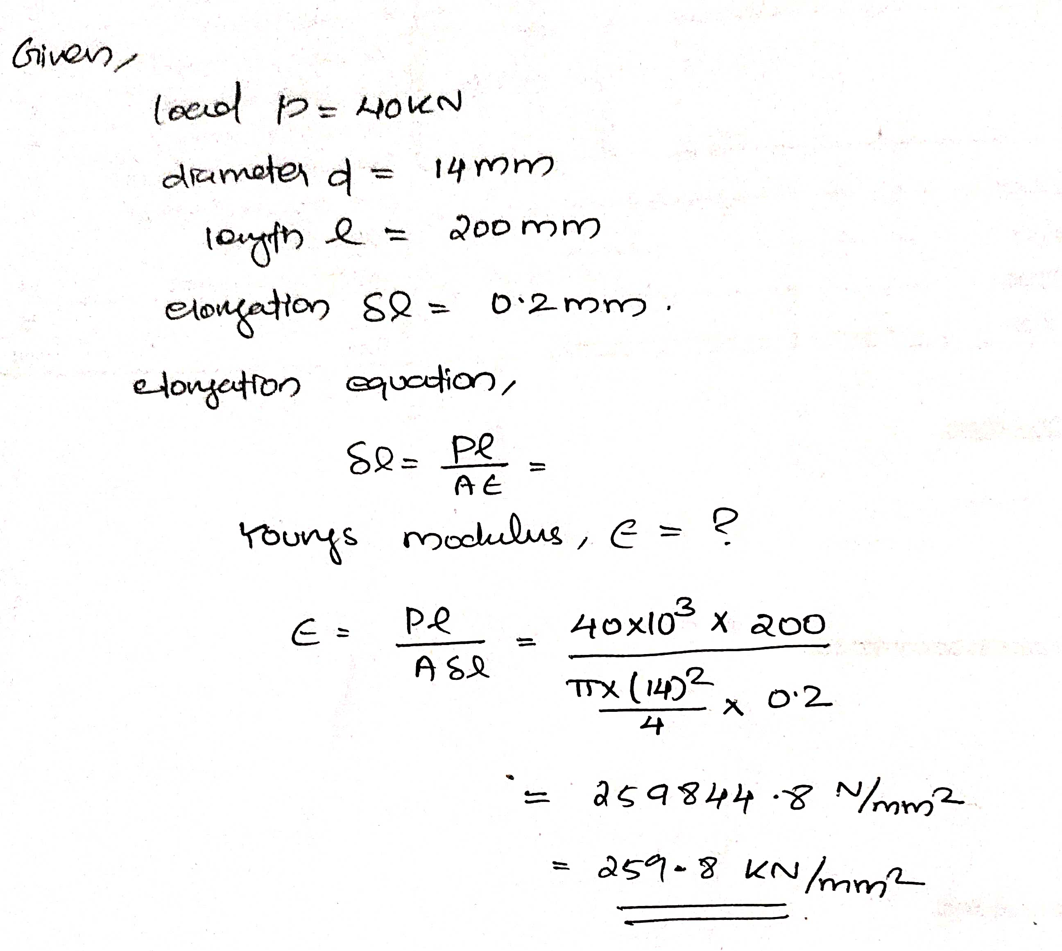
2. Find the Youngs modulus of a steel specimen of 14mm diameter and length 200mm was found to elongate 0.2mm when it is subjected to a tensile load of 40kN.

Slide 22
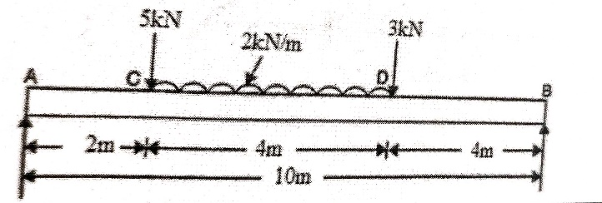
Draw SFD and BMD

Slide 23
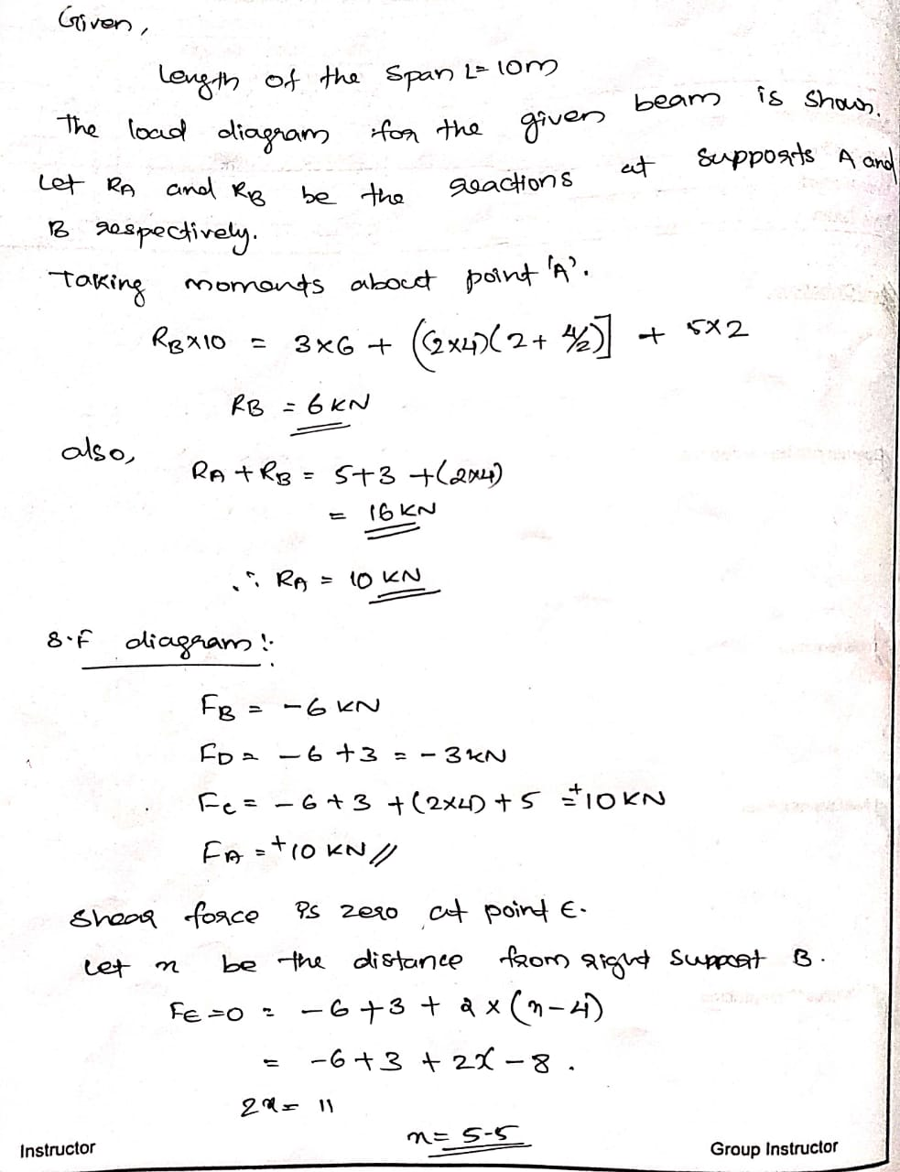

Slide 24
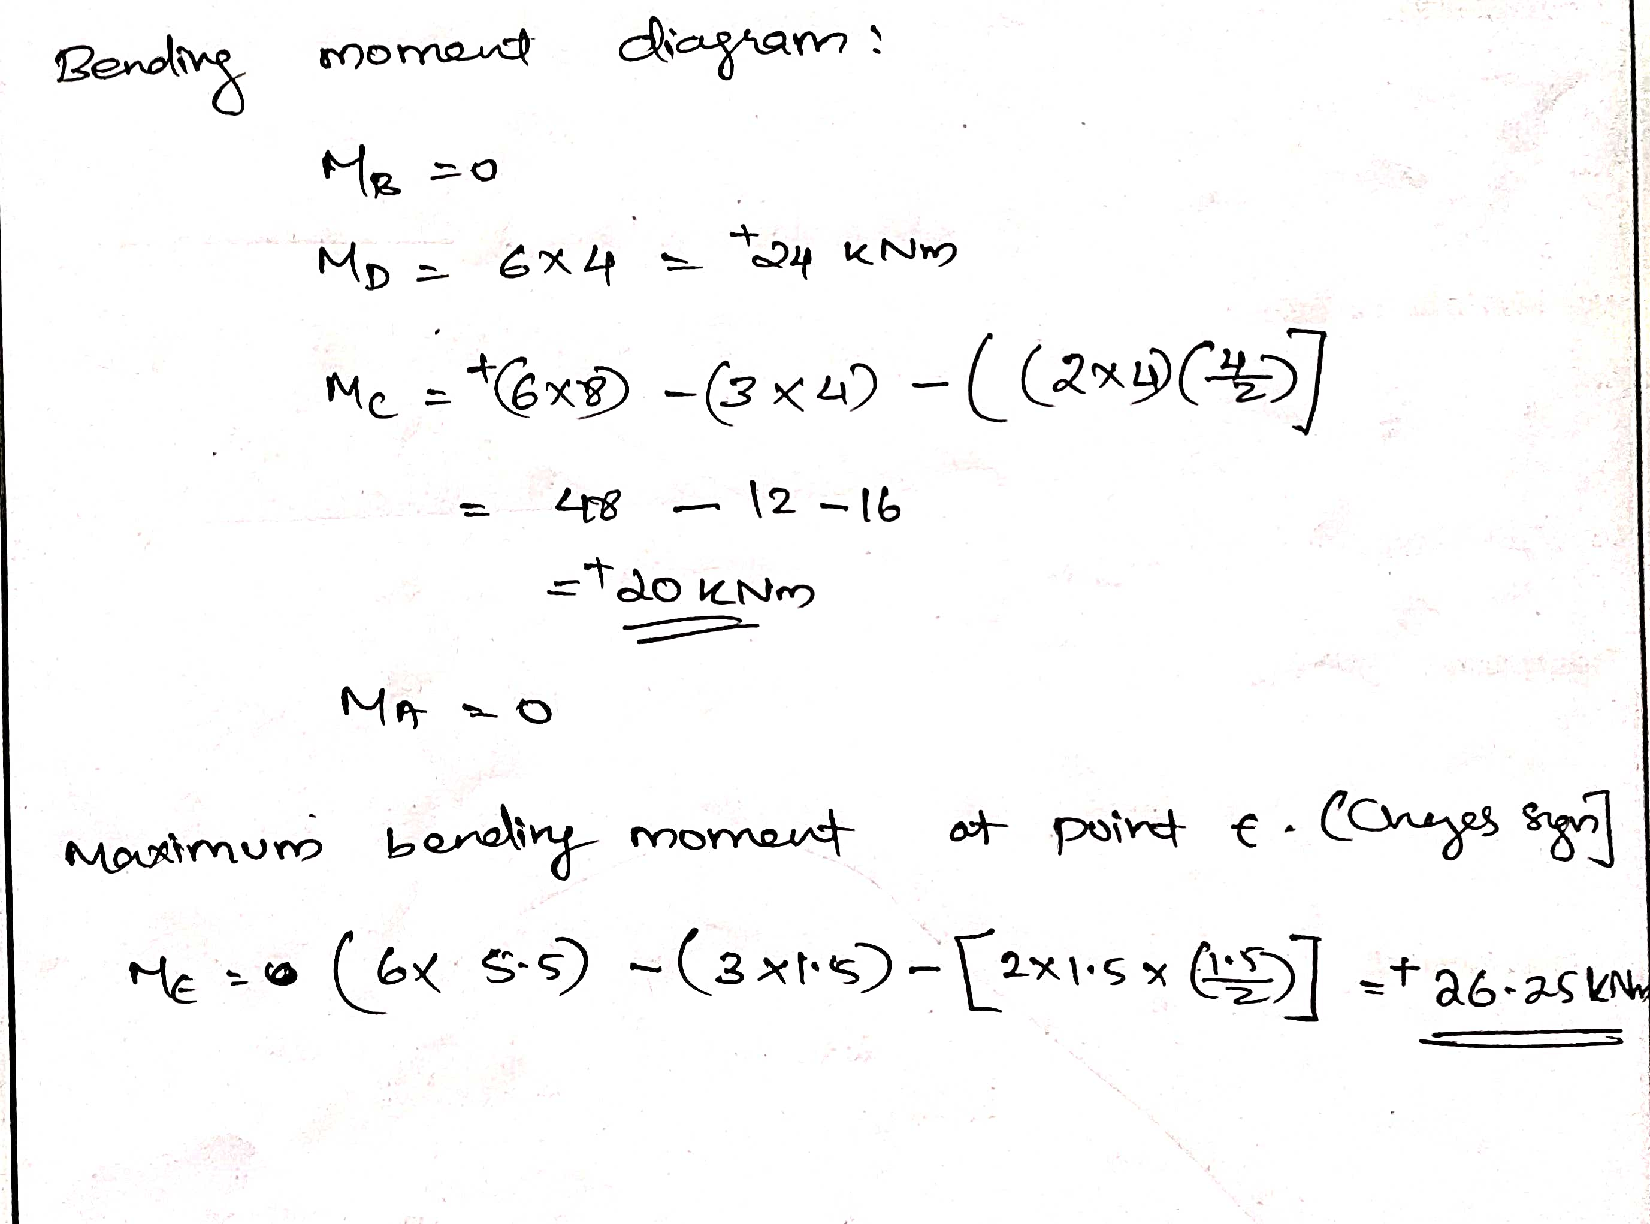

Slide 25
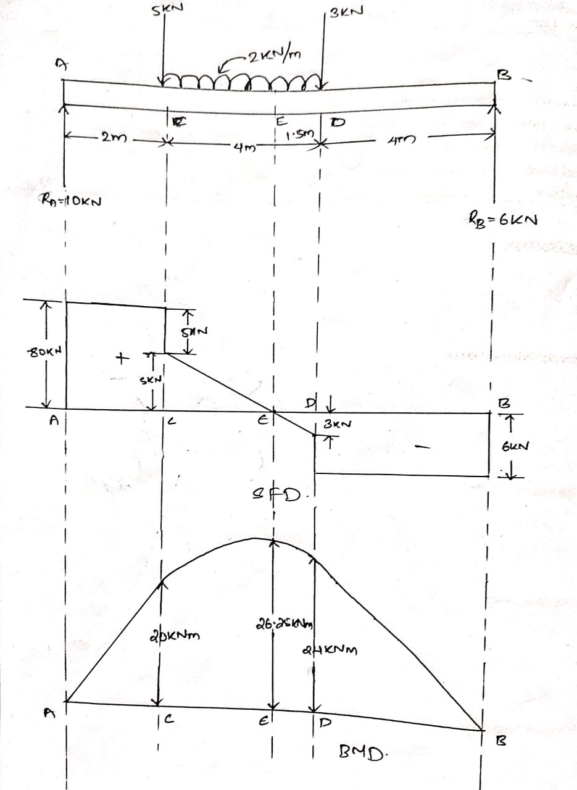

Slide 26
4. list down the important points for drawing SFD and BMD
The bending moment is a maximum when the shear force is zero
SF changes abruptly at points where concentrated loads are applied.
SF graph is a straight ,horizontal line between concentrated loads i.e.,where there are no distributed loads, the shear force is constant between concentrated load points.
SF graph is a straight , inclined line between points when u.d.l is applied.

Slide 27

6. A simply supported beam of span 6m carries a u.d.l. of 2kN/m throughout and a central point load of 12kN. Find the position and magnitude of maximum deflection. E=200kN/mm2, I=24x10⁶mm⁴.
Given : E= 2× 10⁵ N/mm²
I = 24× 10⁶ mm⁴
W = 2 KN/m =2N/mm
Maximum deflection occurs at middle of the span and is equal to sum of deflection due to udl and point load.
Maximum deflection =deflection due to point load +deflection due to udl
Y_{max}= $\frac{wl^{3}}{48EI}+\frac{5wL^{4}}{384EI}$
=6000³/EI ($\frac{12×{10}^{3}}{48}+\frac{10×6000}{384}$) =$\frac{{6000}^{3}×406.25}{2×{10}^{5}×24×{10}^{6}}$ =18.28mm

Slide 28
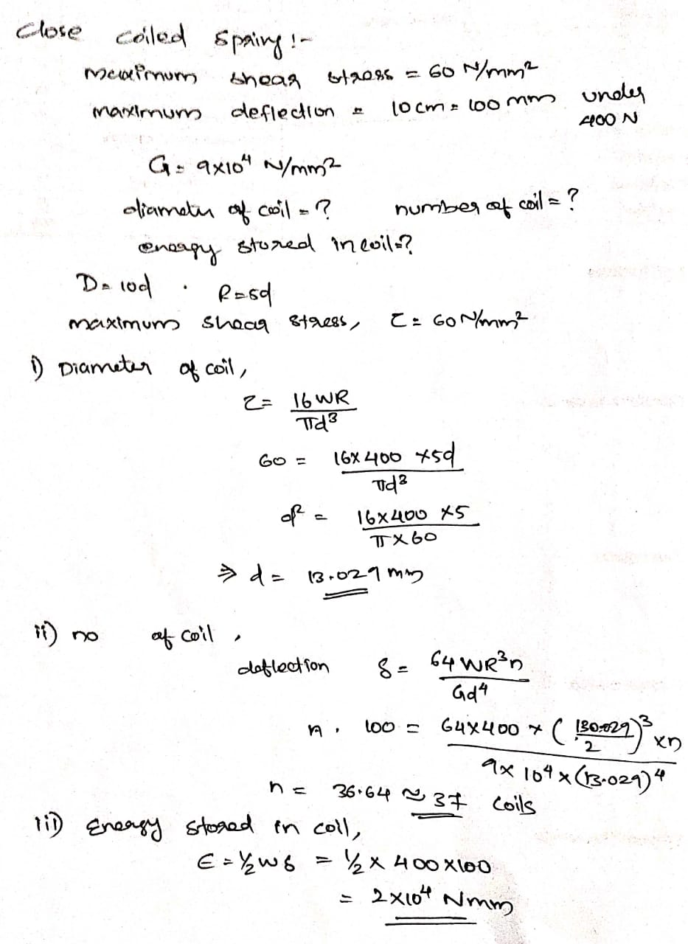
8.In a close-coiled spring, the diameter of each coil is to be 10 times that of wire of the spring and the maximum shear stress is not to exceed 60N/mm2 . Maximum permissible deflection under a load of 400N is 10cm. Taking the shear modulus as 9x104 N/mm2 , determine the diameter of the coil, number of coils and energy stored in the coil

Slide 30
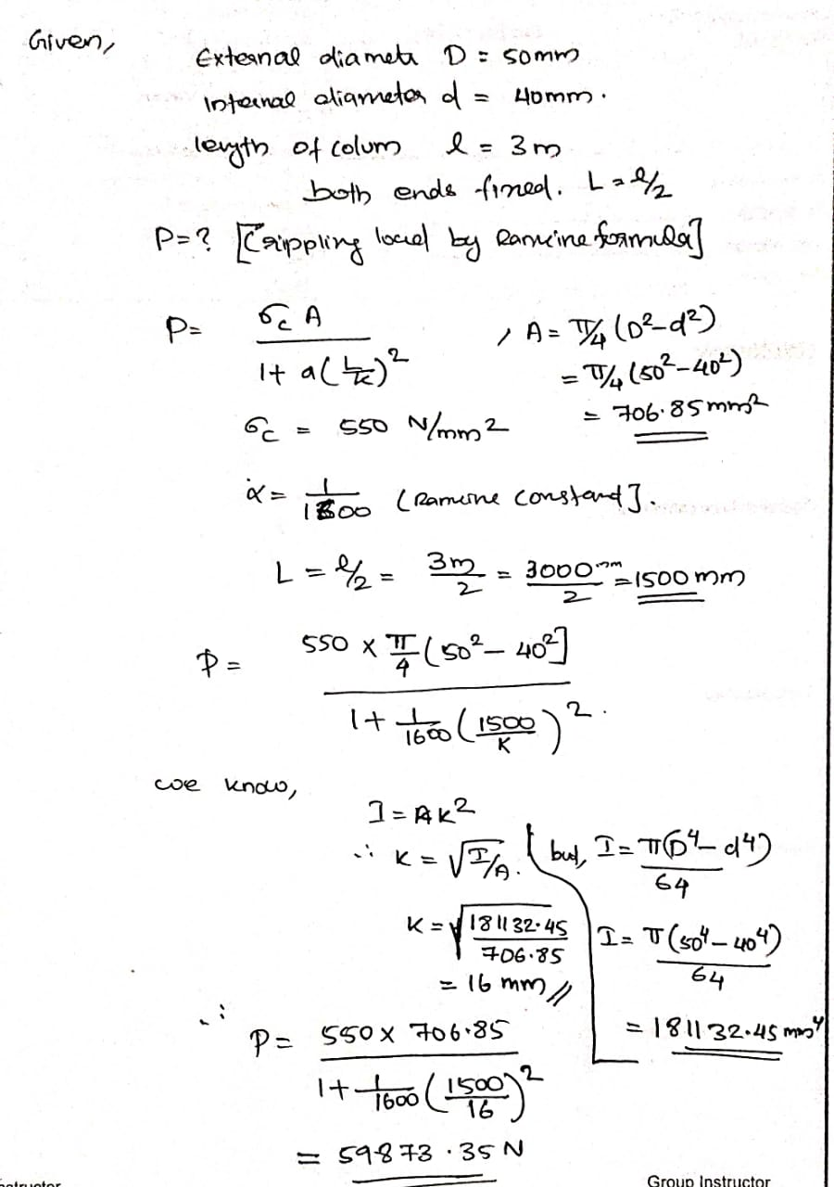
9.The external and internal diameter of a hollow cast iron column is 50mm and 40mm respectively. If the length of the column is 3m and both of its ends are fixed, determine the crippling load using Rankines formulae. Take the values of σc = 550 N/mm2 and α=1 /1600 in Rankines formula

Slide 32
11. A thin cylinder of internal diameter 1.25m contains fluid at an internal pressure of 2N/mm². Determine the maximum thickness of the cylinder if (i) The longitudinal stress is not to exceed 30N/mm². (ii) The circumferential stress is not to exceed 45 N/mm².
hoop stress , σ_{h} = pd/2t or t = pd/2σ_{h} =2×1250/2×45 = 27.78 mm
considering the strength along transverse section ,
longitudinal stress , σ_{t} = pd/4t or t= pd/4σ_{t} t = 2×1250/4×30 = 20.84 mm
considering greater among the two values t = 27.78 mm.
Given,
Diameter of cylinder , D =1.25m =1250mm
Internal pressure, P= 2 N/mm².
Safe hoop stress (circumferential), σ_{h} = 45 N/mm².
safe longitudinal stress , σ_{t} = 30 N/mm².
Considering strength along longitudinal section ,

Slide 33
Thank you

